Slide 1


JobNest
Nest Your Career with the Right Job.
Start With Us

Slide 2

About JobNest
JobNest is a modern job portal that connects recruiters and job seekers. Recruiters can post jobs and manage applicants, while seekers can search jobs, calculate salaries, explore resources, and manage their profiles — all in one platform.

Slide 3





Technologies Used
Frontend
Backend
React.js
Vite
Tailwind CSS
React Router
Node.js
MongoDB
Mongoose
RazorPay

Slide 4
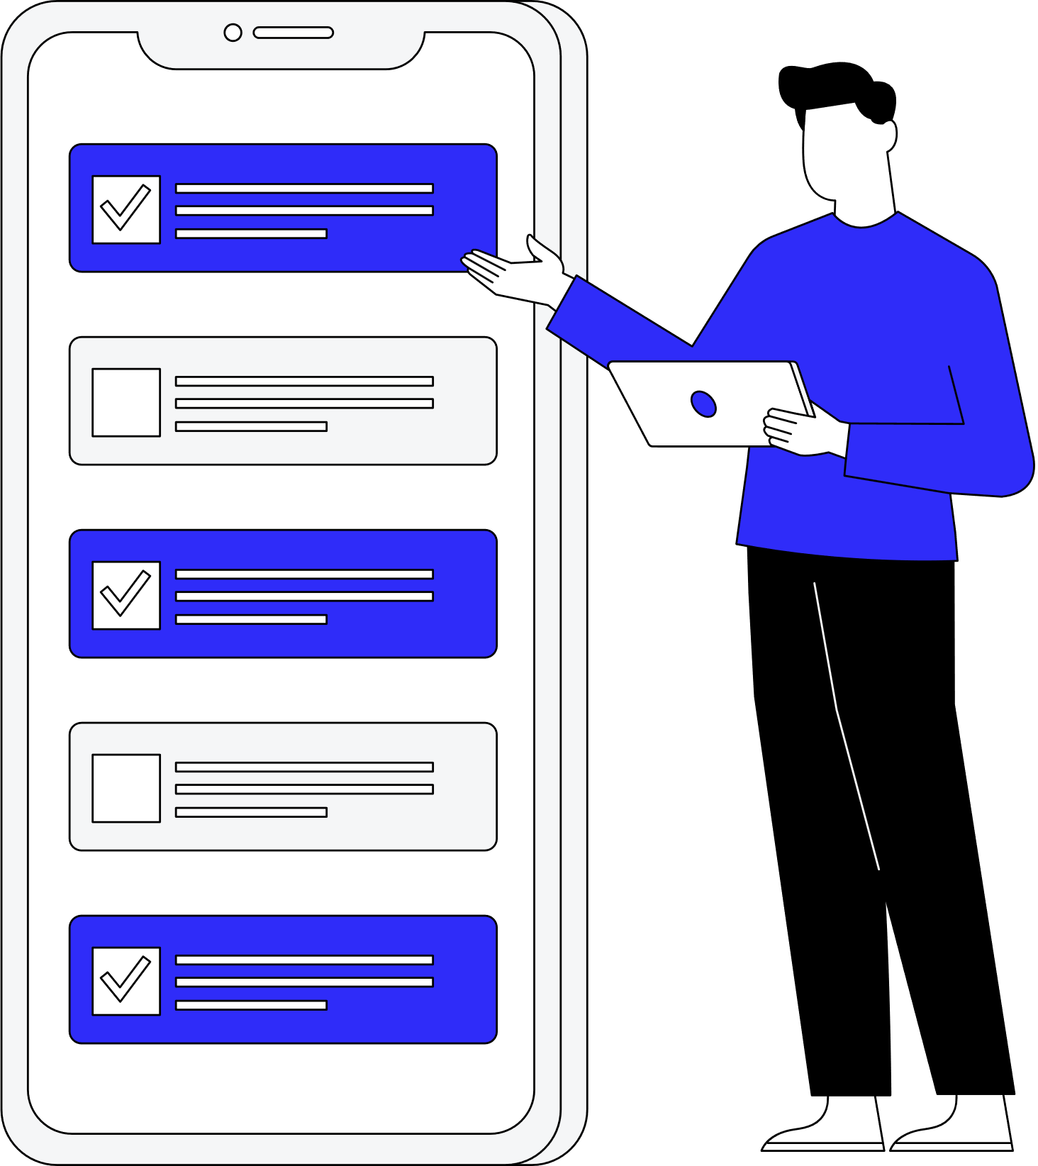
Key Features of JobNest
Advanced Job Search with filters (title, location, domain)
Profile & Resume Upload for job seekers
Career Advice & Learning Resources
Company Profile Page for branding
Notification System for updates & status

Slide 5
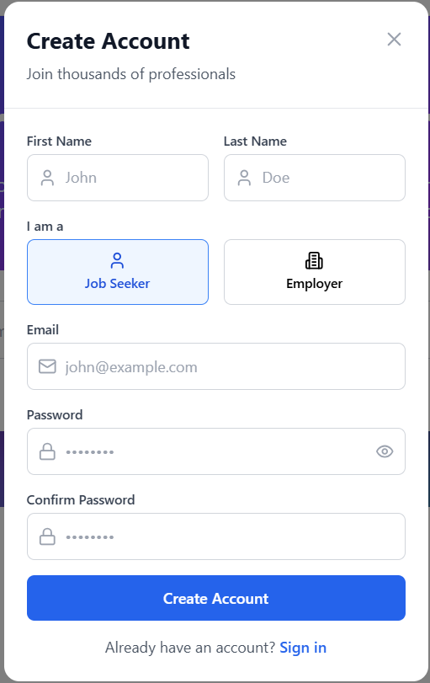
Login Page
Secure login system for Recruiters and Job Seekers.
JWT-based authentication to protect routes.
Redirects user to appropriate dashboard post-login.
Connectivity
Leads to dashboard or homepage based on user type.

Slide 6
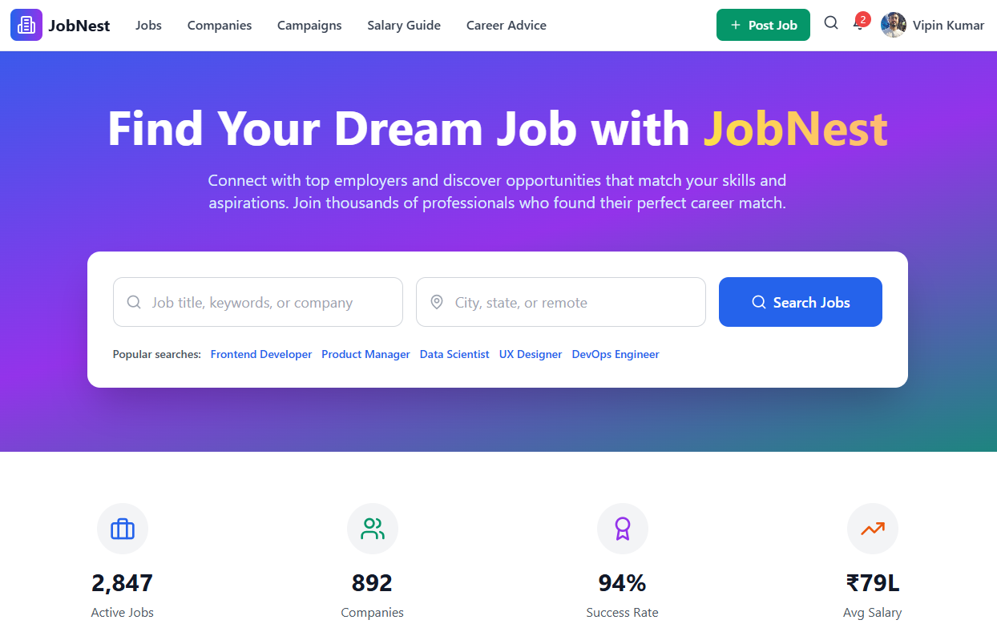
Landing Page
Engaging landing page for new users.
Job search bar with filters like job title, location, and field.
Smooth transition to job listings page.
Connectivity
Navigates to Job Page on search.

Slide 7
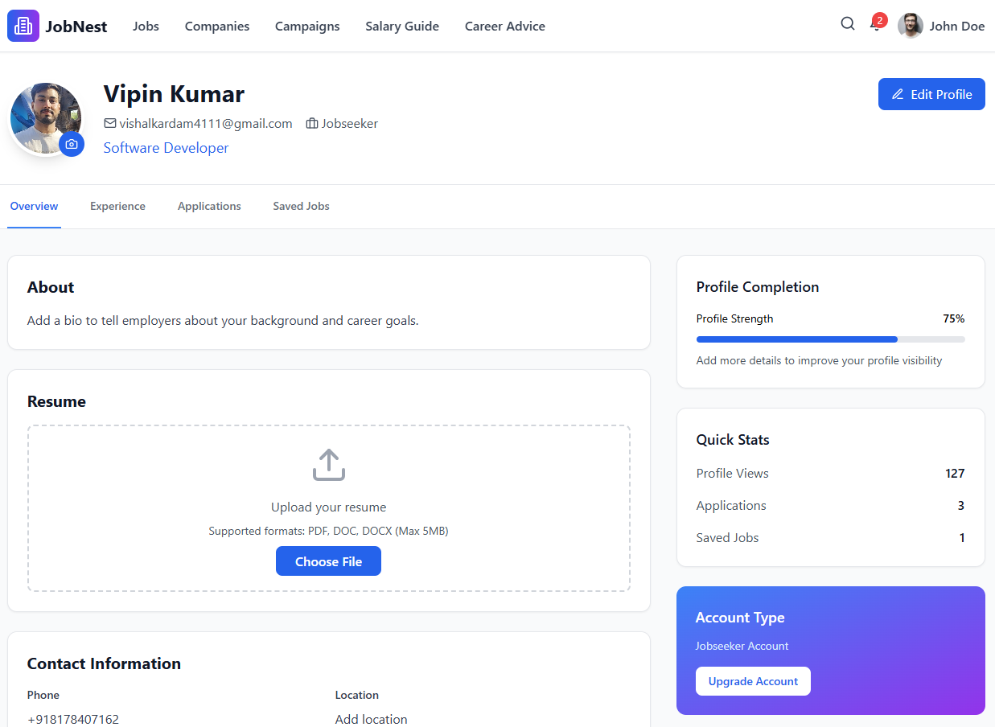
User Profile Page
Profile for both Recruiters and Job Seekers.
Editable details, resume upload, education info, etc.
Connectivity
Accessible via navbar profile icon.

Slide 8
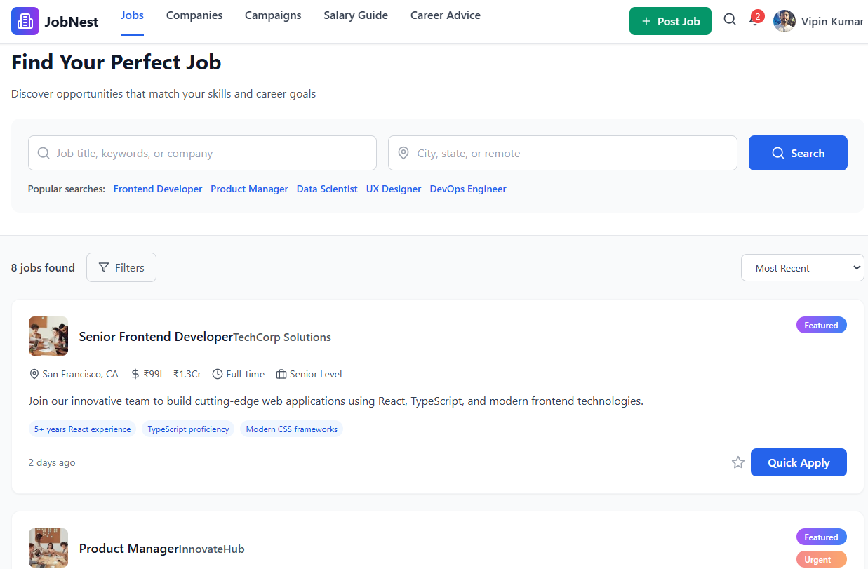
Jobs Page
Lists all jobs posted by recruiters.
Filters applied from landing page reflect here.
Paginated and searchable layout.
Connectivity
Clicking a job opens Job Details

Slide 9
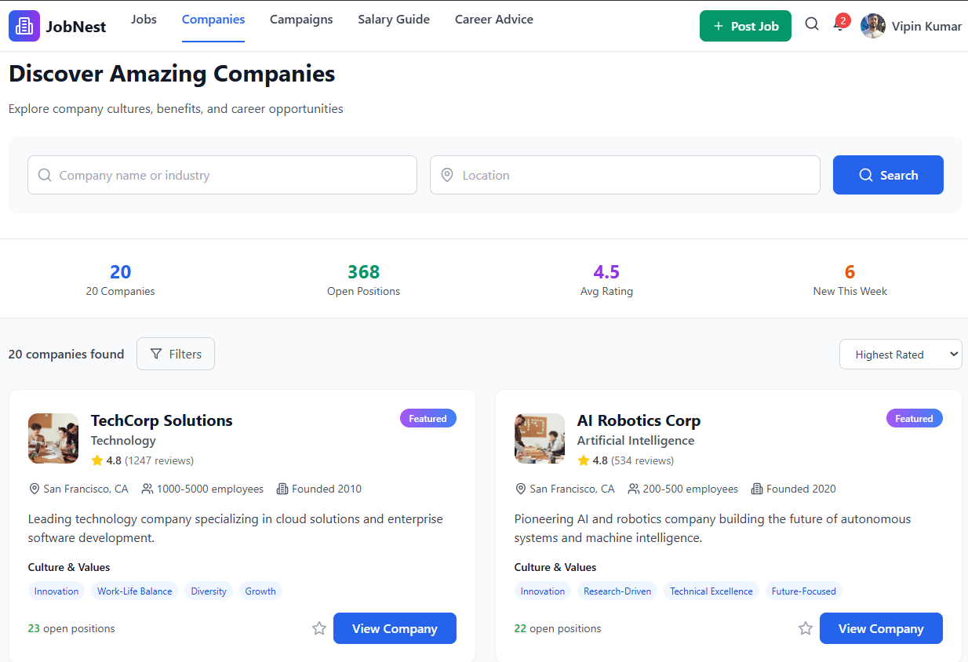
Company Profile Page
Dedicated page for companies and recruiters.
Shows company details, posted jobs, and branding.
Connectivity
Linked from job post and recruiter profile.

Slide 10
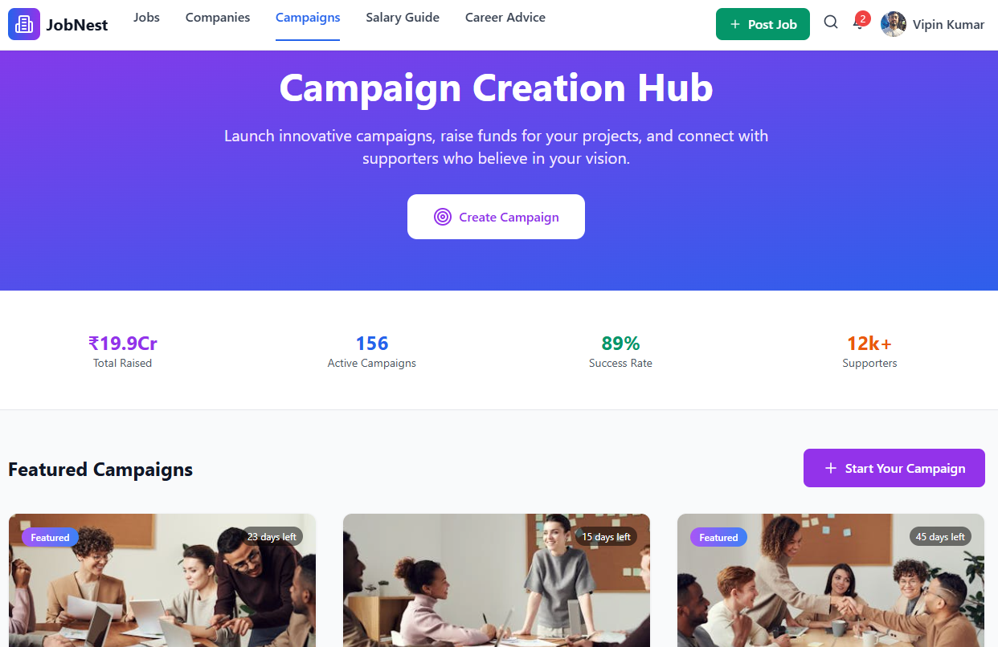
Campaigns Page
Each campaign links to associated Company Page and full Job Details.
Highlights special hiring events, walk-ins, and job fairs.
Connectivity
Connects job posts with seekers through campaigns for better reach and engagement.

Slide 11
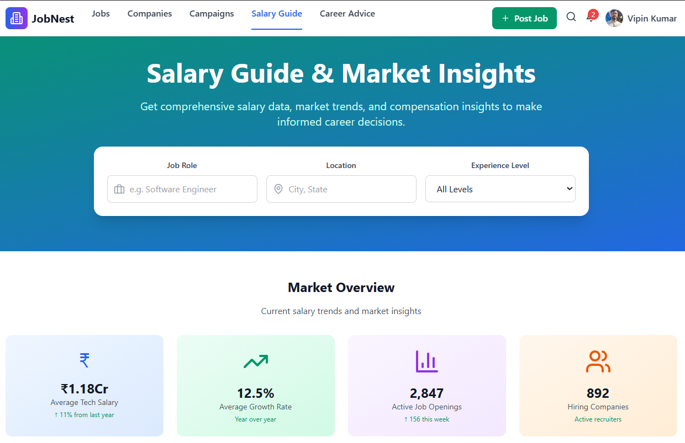
Salary Guide Page
Salary calculator for job seekers to estimate pay.
Lists top paying roles in different industries.
Connectivity
Accessed from navbar or resources page.

Slide 12
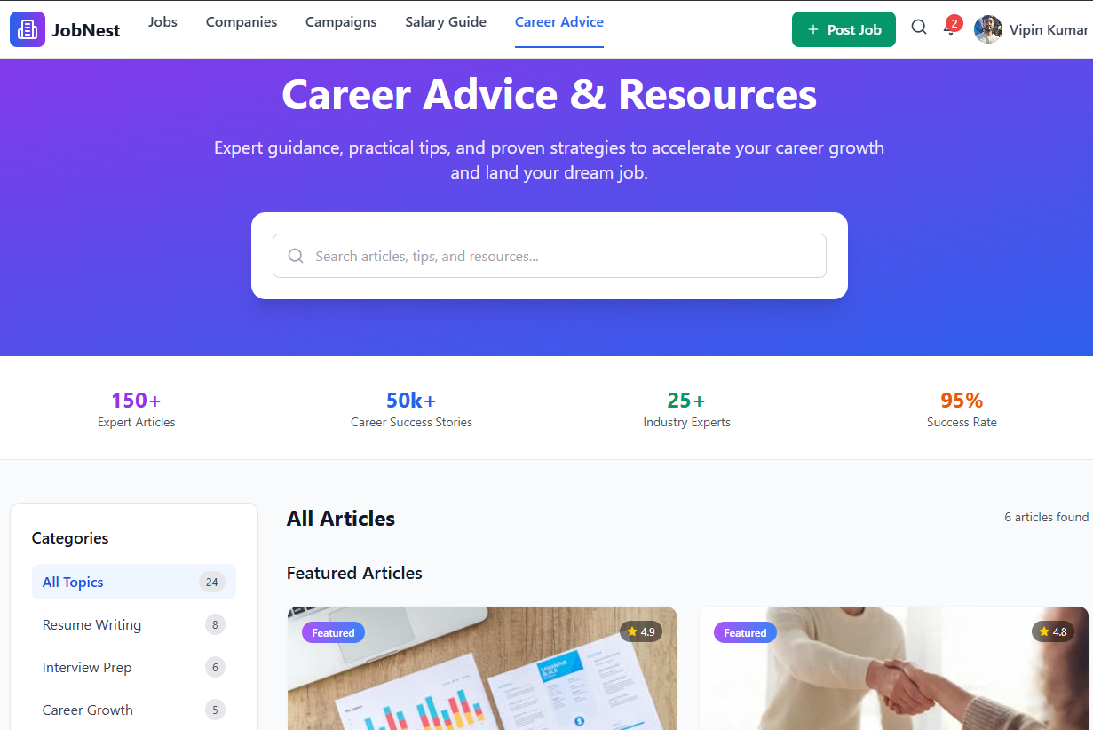
Career Advice Page
Resources like recommended courses, interview tips, resume writing, etc.
Helps seekers upskill and prepare better.
Connectivity
Links from dashboard, sidebar, or profile page.

Slide 13
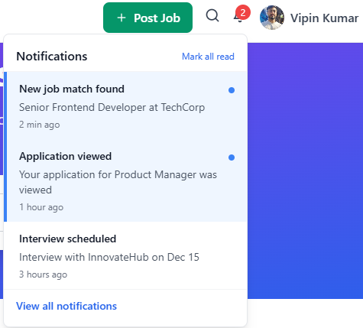
Notifications System
Notification bell in navbar for job updates, application status, etc.
Real-time or dynamic updates based on actions.
Connectivity
Accessible via navbar Bell icon.

Slide 14
Page Flow
Landing
Search
Job Page
Login/Signup
Dashboard
Profile/Job Post/Notification
Nav Link
Salary Guide, Resources
Emphasis on seamless navigation and user-centric layout.

Slide 15
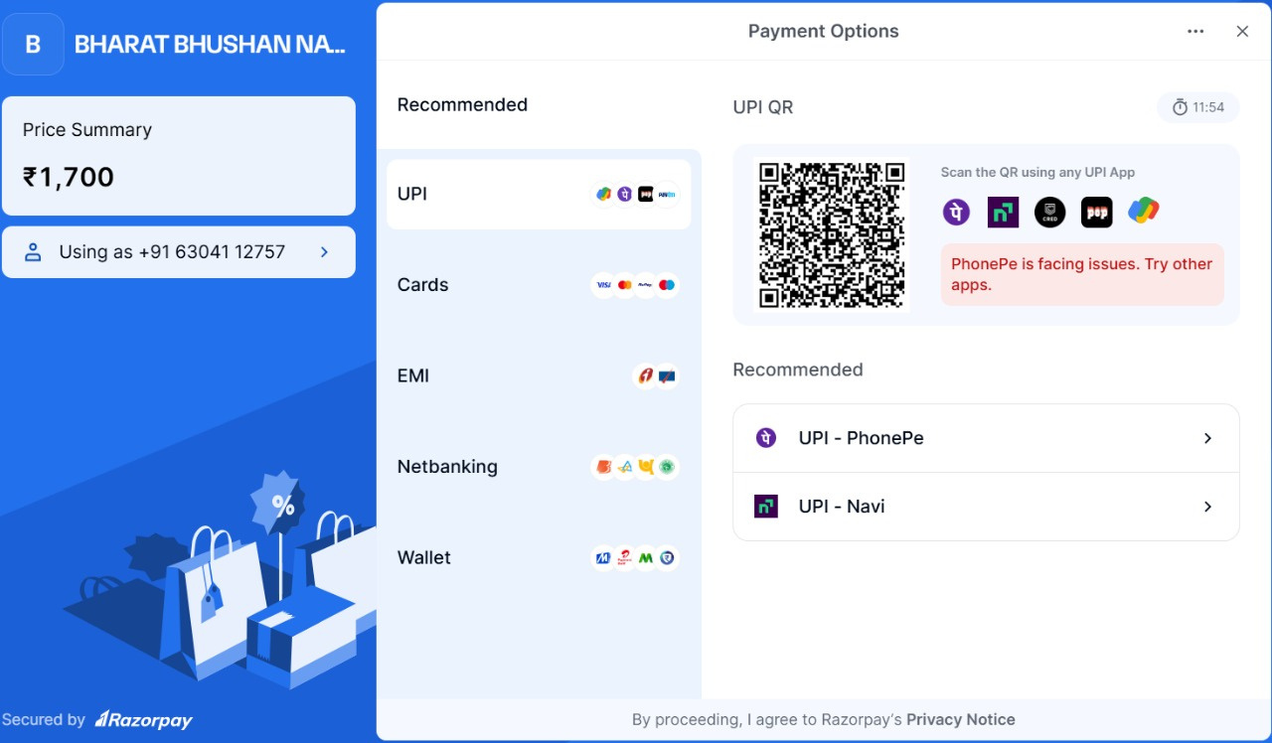
Razor Payment Gateway
Job Seeker premium

Slide 16
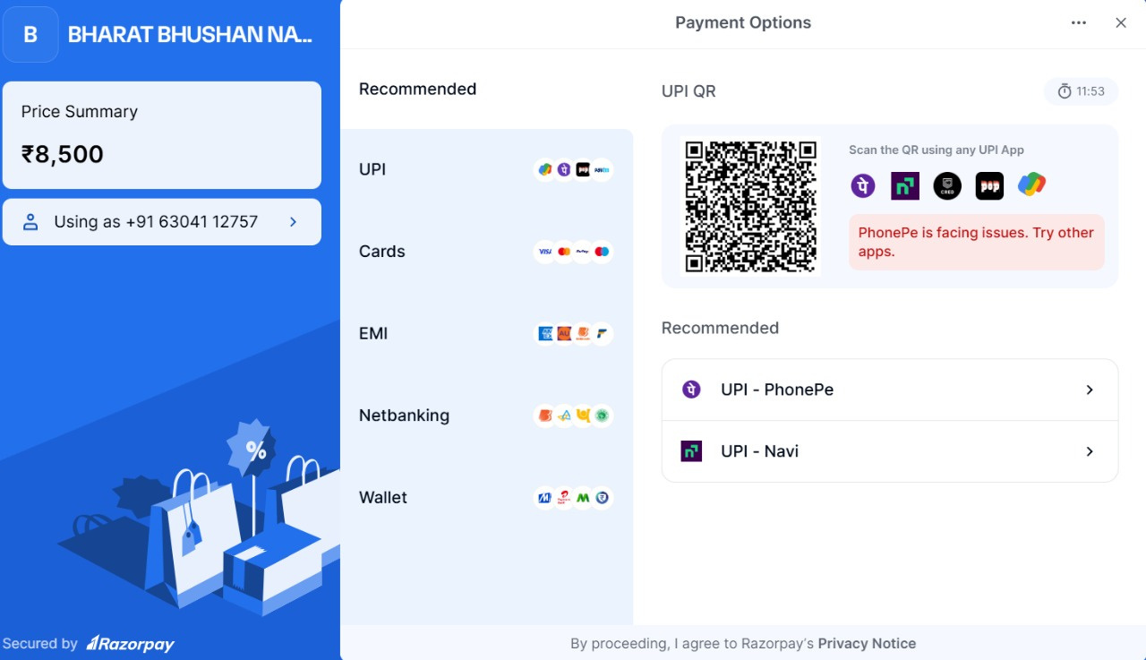
Razor Payment Gateway
Employer’s Premium

Slide 17
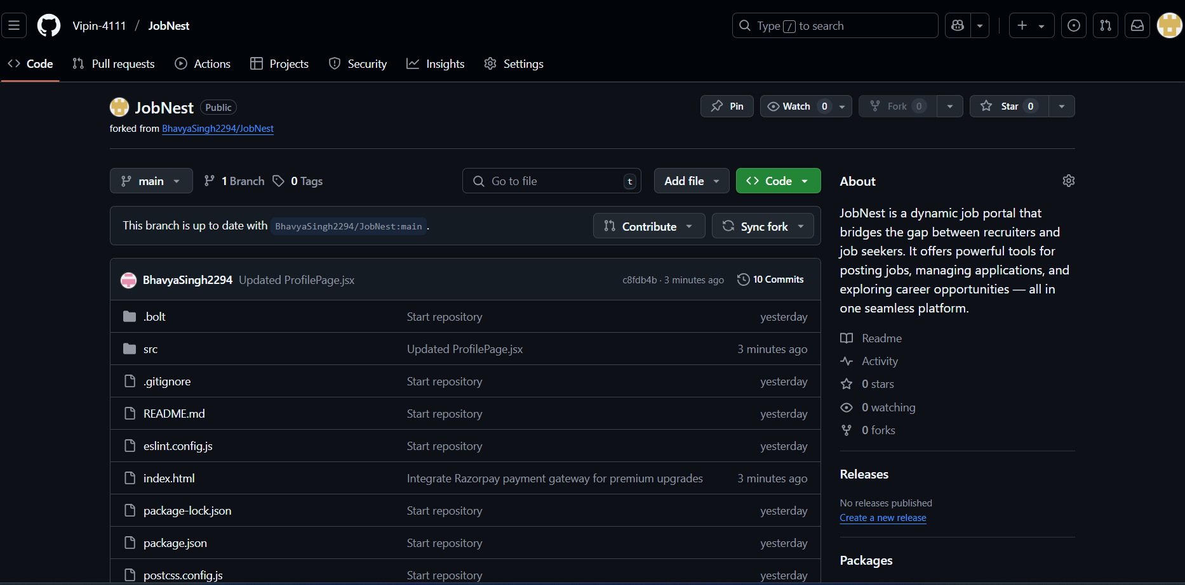
Github Repository

Slide 18

QnA
Any Question ?

Slide 19




Thank You
https://gorgeous-empanada-2248c4.netlify.app/

